Slide 1

High School Diving
Event Manager
Prototype 3
Jacamar
March 29, 2023

Slide 2
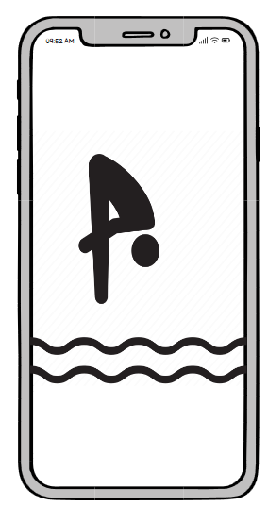
App Startup
[No changes from Prototype 2]
Displayed briefly when launching
Replaced immediately by initial presentation of settings screen on first launch, otherwise transition directly to the role's main screen
User waits

Slide 3
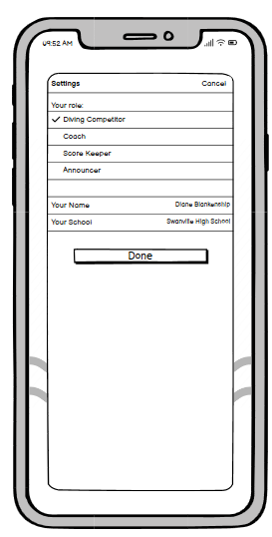
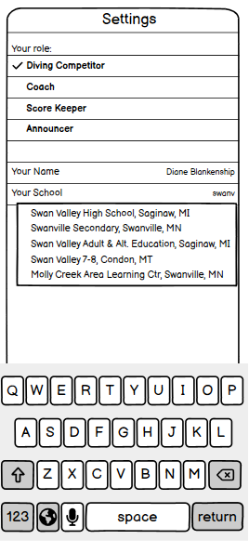
User Settings/Setup
[No changes from Prototype 2]
To reduce errors when entering the school name:
As letters are typed, they are matched against a list of all US schools*, and once the number of possible matches is manageable, a drop down list appears with the candidates. This can be pared down by further typing. Any candidate school on the list may be tapped to choose it, or a name not on the list may be entered.
(* about a ~10mb file, stored locally)
Settings screen: Modal presentation over prior content
Cancel is not visible during initial setup
Cancel is visible when returning to this screen after setting up
The bottom two rows appear if "diver" or "coach" are selected. (Score keeper and announcer don't need to enter their name or school.)
If a coach or diver returns to this screen after initial setup and picks a scorekeeper/announcer role, any state associated with the prior role is not discarded; it just becomes hidden until the user switches back to coach/diver.
The app is designed to support one role at a time, and frequent role switching is not an expected use case
User enters settings and selects “Done”

Slide 4
Major Task 1: Dive Entry
iOS Mobile

Slide 5
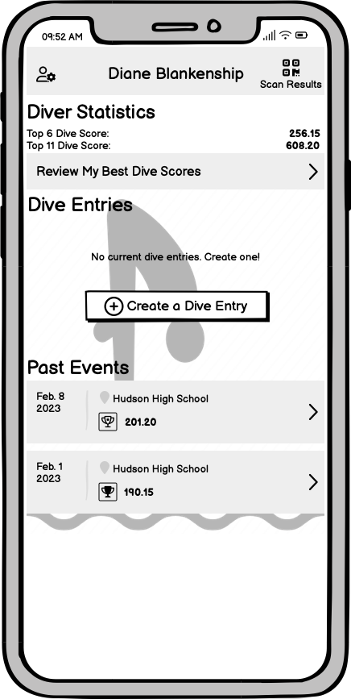
Diver Home Page
Dive Entries, and possibly Past Events may be swiped left to reveal a "remove" action
Tapping a past event pushes to the diver's results screen
"head+gear" button (upper left) re-presents the initial settings screen
New for Prototype 3:
Past dive scores are available for review by dive. See “Best Dives” screen.
Why? User tracks data in a spreadsheet today. We have the data already, so we added a display to easily review top dives.
User selects “Create a Dive Entry”

Slide 6
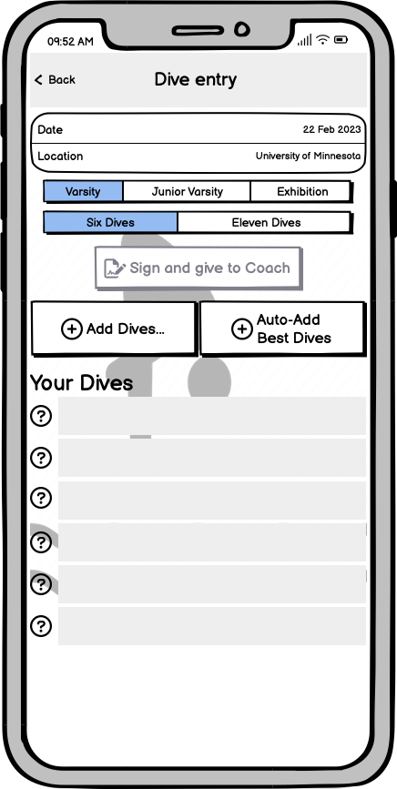
Dive Entry - Empty
Tapping "back" returns to the diver main screen, but if anything has been entered here, it is saved in a new Dive entry row
"Date" pops a platform-provided date picker constrained to current/future dates
"Location" may use a pop-up candidate list similar to "Your School" back on the settings screen.
Tapping an empty dive slot does the same thing as Add Dives
Tapping "add dives" moves to the Select Dives screen
New for Prototype 3:
An auto-add button will preselect a “best” slate of dives according to domain rules and past scores.
Why? Users did not quickly see the scores on the busy add dive screen. By including the auto-add, the top scoring dives are pulled in and can be removed from this screen or used as point of reference as checked in the add dive screen to make changes. This greatly simplifies our Create Maximum Score Dive Entry task from user testing.
User selects “Add a Dive”

Slide 7
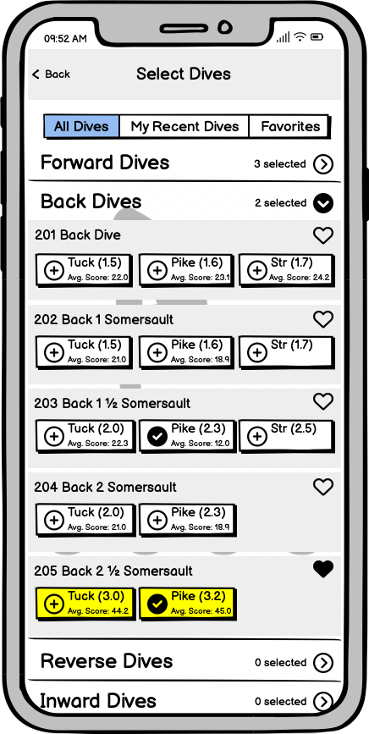
Selecting Dives
Tapping a heart toggles a dive's presence in the "favorites" group
Tapping a button with + adds the dive and position to the entry, and the button becomes ✓
Tapping it again removes the dive from the entry and reverts the button back to a +
A diver may not do the same dive twice, even in two different positions; so, if they tap a different position for a previously chosen dive, the check is moved.
Because the list of dives is so long (70+!), we use an "accordion menu".
The five categories of dive are displayed with >, and with no dives visible. Tapping a category expands it and changes to v (here "Back Dives" is shown expanded.)
Expanding any category collapses any other expanded category. Tapping an expanded category also collapses it, so all categories may be collapsed.
Return to the dive entry with "Back" once some desired dives have been checked.
New for Prototype 3:
The diver’s best two dives (per category) are highlighted
Scores were moved onto the buttons
Why? Users did not quickly see the scores on the busy add dive screen. By highlighting the top two score helps the user find past high performing dives. Two are highlighted because a dive entry typically has up to two dives per category. By moving the score onto the button, the user will more closely relate the data to the dive with a position.
User chooses all desired dives and taps “Back”, 2 slides ahead
(or, alternatively, uses the “Favorites” tab, next slide)

Slide 8
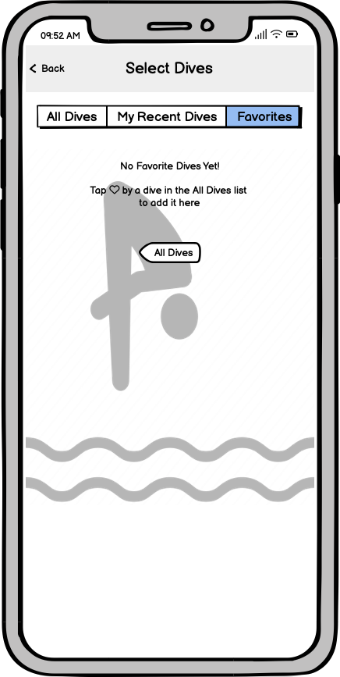
Selecting Dives - Favorites
New for Prototype 3:
Favorites has an empty state with a placeholder to guide the user back to the “all dives” list when no favorites are picked yet.
(Once some favorites are picked, “Favorites” looks similar to “All Dives”.)
Why? When asked to create a list of favorite dives, the user went to the favorites list which was preloaded with some test data. Then, the user was able to easily remove dives, but was unsure how to add them until the first successful add. The new information on the empty list will guide the user to add favorites from the all dives if none have been chosen. Once the concept is understood and favorites added, the user will no longer need the guidance.
User chooses all desired dives, under whichever tabs they like, and taps “Back”

Slide 9
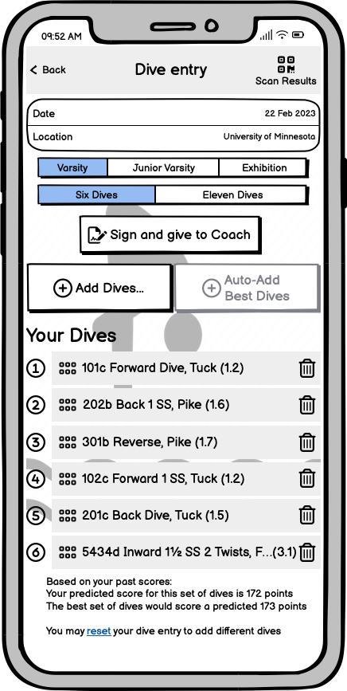
Dive Entry - In Progress
Bars with ::: may be dragged to reorder, or swiped left to show a "remove" option
As dives are added, the circled question marks (see “Dive Entry - Empty”) are replaced by numbers. Numbers stay in place when reordering dives
Entire form may be scrolled vertically if many dives are selected
If more than six (or eleven) dives are added, they are shown similarly, but the supernumerary ones get ⚠ instead of a number. It is desirable to allow extra dives to be temporarily added, so the diver can assemble a candidate list and then pare it down.
“Sign and give to coach" button enables once there are 6 or 11 dives on the sheet and list is valid
After giving the dive sheet to the coach, the button changes to "Give to Coach Again"
Making changes after that clears the signature, and reverts the button back to its original state
The “Scan Results” button only appears once the dive sheet has been signed & the QR displayed
New for Prototype 3:
Using past score data, the predicted score for this chosen set of dives is compared to the “ideal” set (see “Dive Entry - Empty”). This comparison is shown below the dives. The option to erase the dives and start over is offered.
Why? Users were interested in using historical averages to build a best dive entry. By adding the predicted score and comparing to the predicted best score, the user can reorder the dives and compare the potential for high scores.
User deletes extra dives and reorders remaining dives

Slide 10
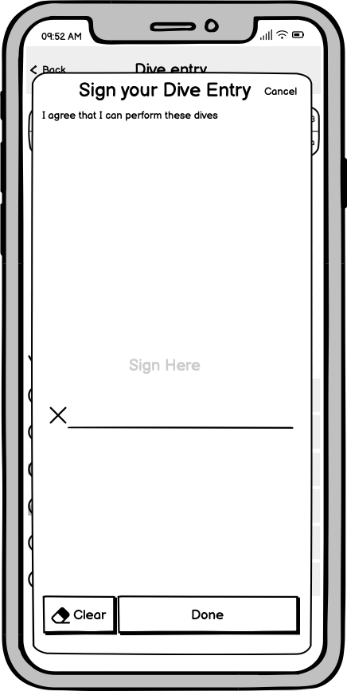
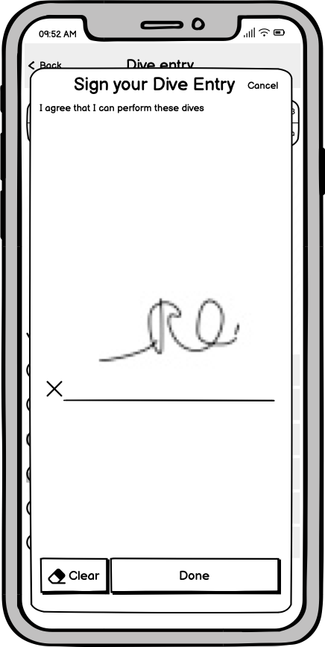
Diver Signing
"Done" is disabled until something is scribbled in the signature area
"Done" moves to QR display
This step is skipped if this entry has already been signed before (button on Dive entry screen goes straight to QR)
“Clear” erases signature and re-disables “Done” btn
New for Prototype 3:
Explicit instructions what to do here.
Visual conventions for signature
Why? Both our users were baffled by the big white void.
User signs and selects “Done”

Slide 11
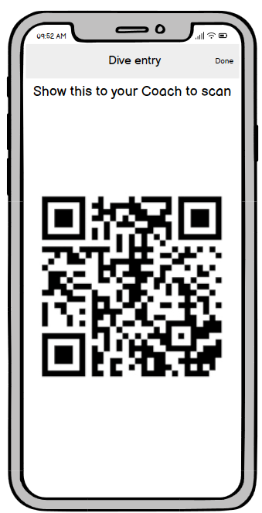
Dive Sheet QR
[No changes from prototype 2]
All extra borders and chrome are hidden to help make scanning easier. The top title and instruction fades out after a few seconds to facilitate this
A tap anywhere re-reveals the top bar/done button. "Done" returns to the dive entry.
A *swipe* anywhere dismisses this screen and returns to the dive entry. (Swipe is the platform convention for dismissing full-screen photos)
User presents QR code to Coach for scanning, closes the app, goes and competes.

Slide 12
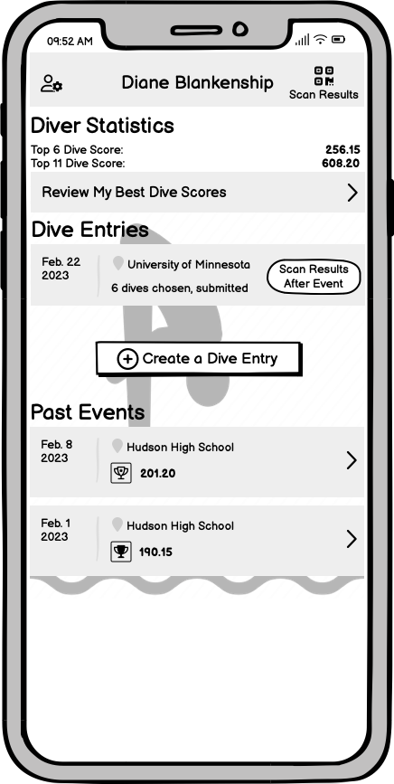
Diver Home Page (after dive entry creation, and after the event)
New for Prototype 3:
After the event, we make the path to get your results as obvious as we can, with two scan results buttons (in addition to the one on the dive entry itself)
Why? Users were unsure where to find the scan results feature at the completion of the event.
User presses any of the Scan Results buttons

Slide 13
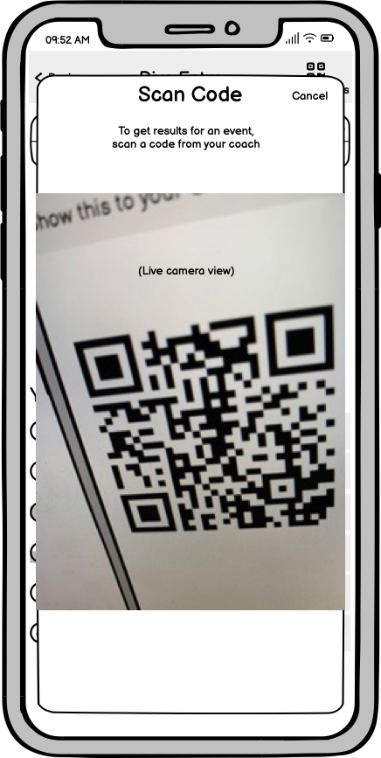
Scan Event Results QR
[No changes from Prototype 2]
User has completed all dives and meet has concluded
(Option to Scan Results shown on slide 8)
Scan a QR code containing the event results (from coach's phone, although direct from a scorekeeper will also work)
Once a coach has collected the results of the event, they can display them as a QR for their athletes to scan.
After a successful scan, or on tap of "cancel", returns to prior screen (dismisses scanner).
If the prior screen was a Dive Entry, and this scan contained results for that dive entry's event, the dive entry screen is replaced by a Event Results screen
User scans QR Code

Slide 14
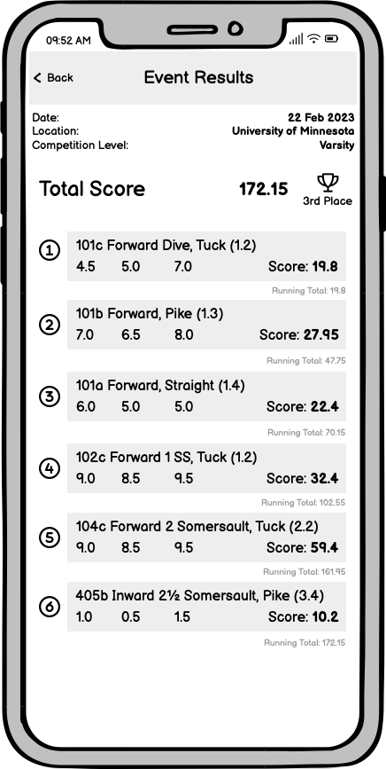
Event Results
Scanning a results QR replaces that event's Dive Entry with Event Results
Content is not editable
Note: total score is the sum of the 3 judge scores, multiplied by the "degree of difficulty" (the number in parens after the dive name.) We expect the divers already know this derivation well and it should not need an explanation
New for Prototype 3:
Added running total after each dive
Why? Users expressed interest in seeing their running total after each dive due to some events having cutoffs after a certain number of dives.

Slide 15
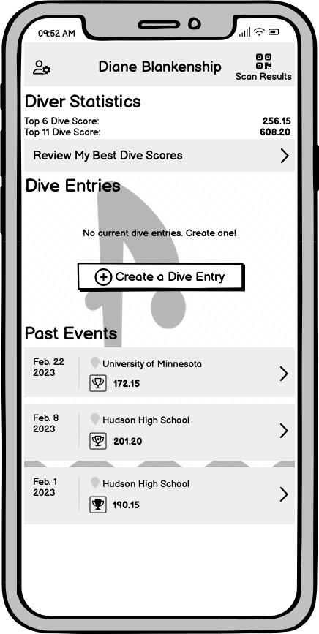
Diver Home, after scanning results
New for Prototype 3:
Scores from all past events may be reviewed (returning to previous slide)
Scores may also be reviewed by dive
Rather than just show the two best dives on this screen, we afford pushing into a list of all dives dived
Why? User tracks data in a spreadsheet today. We have the data already, so we added a display to easily review top dives.

Slide 16
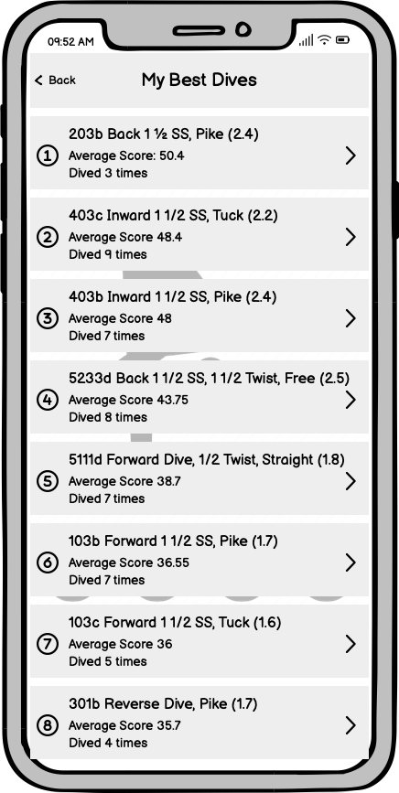
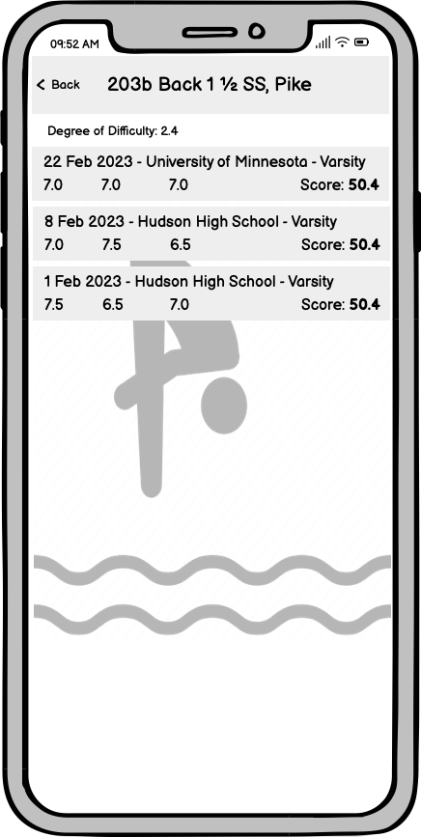
Best Dives, and Detailed Dive Data
New for Prototype 3:
All dives dived are listed here, in order of average score
Tapping on one pushes to a detailed breakdown of all scores earned for that dive
Why? User tracks data in a spreadsheet today. We have the data already, so we added a display to easily review top dives.

Slide 17
Major Task 2: Keep Score
Android Mobile

Slide 18
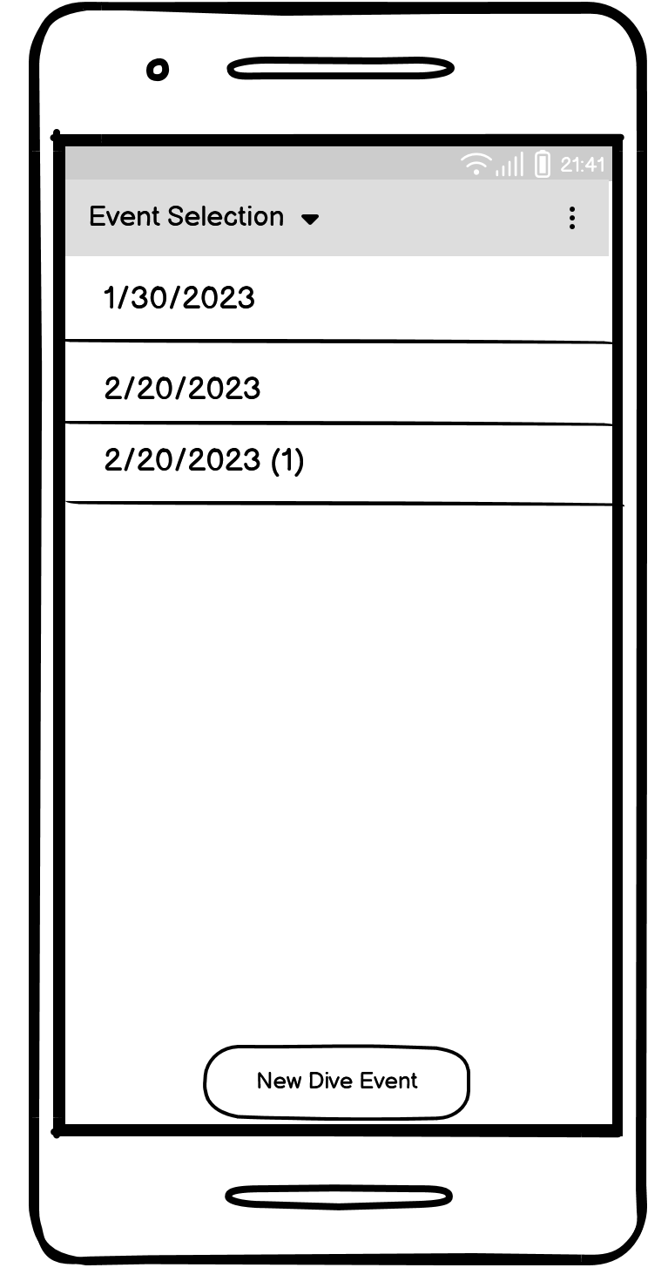
Event Selection
[No changes from Prototype 2]
Displays a list of all events this scorekeeper has kept score for previously. Events are displayed by the date they occured. If multiple events are added on the same day, the event has a revision number added in parentheses.
Scorekeeper has the option to select one of the previous events or start a new one
Standard swipe left to activate delete option is available on this screen
User selects “New Dive Event”

Slide 19
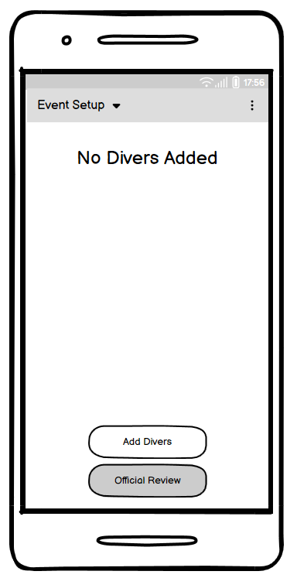
Event Setup - No Divers
Initial setup page displays a message indicating that no divers have been added to the event yet
There is an option to add divers and an option to proceed to official review, which is grayed out until divers have been added
New for Prototype 3:
Start Event button has changed to Official Review
Why? User testing showed some confusion when starting the event and making sure the official reviewed the dive entries. We attempted to clear this up by renaming the button.
User selects “Add Divers”

Slide 20
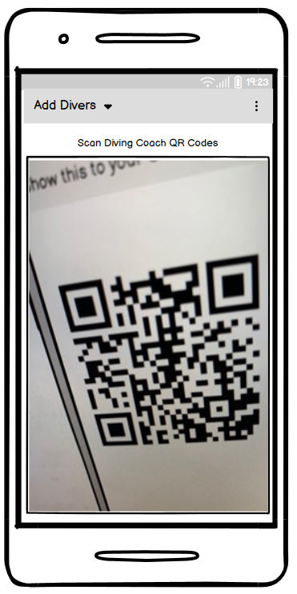
Add Divers
Scanner for reading the QR code generated by the dive coaches in order to read in diver information for a given coach’s team
New for Prototype 3:
Added “Live Camera View” picture
Why? User did not realize this was a live camera during user testing.
User scans a coach’s QR code

Slide 21
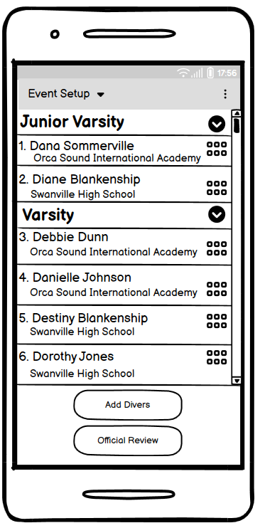
Event Setup - Divers not Ordered
All added divers are listed within the level selected
The grabbers can be used to reorder the divers within the level.
Official Review button is no longer grayed out
New for Prototype 3:
Same modification of “Official Review” button
User arranges divers in the desired order

Slide 22
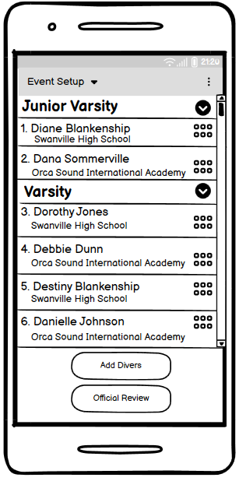
Event Setup - Divers Ordered
New for Prototype 3:
Same modification of “Official Review” button
User selects “Official Review”

Slide 23
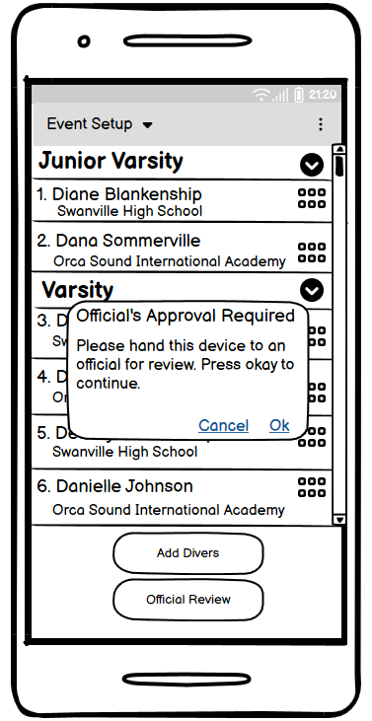
Event Setup - Divers Ordered Process Check
After the scorekeeper selects “Official Review”, an alert pops up to tell the scorekeeper to get approval of the dive event from the Official before the event starts.
If the scorekeeper selects Cancel, the app will stay on the reordering screen.
See minor task 3 for details on the Official Review
New for Prototype 3:
Pop up dialog wording changes
Why? User did not realize the official did not have their own device to perform the Official Review. We attempted to make our call to action more clear with this pop up message. We want the user to understand that now is the time to hand the device to the Official.
User selects “Ok”, go to Minor Task 3

Slide 24
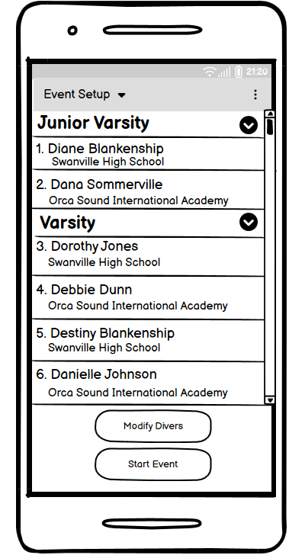
Event Setup - Approved by Official
New for Prototype 3:
New, unmodifiable event setup screen
After an Official has reviewed, approved, and handed the device back to the scorekeeper
User can start event
User can modify divers, which bring them back to the modifiable event setup screen. Official review must happen again if event is modified.
Why? We want the scorekeeper to be the user to start the diving event and give them an opportunity to make last minute changes before the event.
User selects “Start Event”

Slide 25
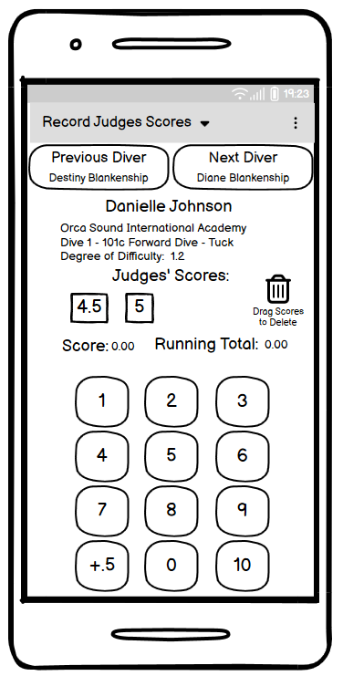
Record Judges Scores
Displays information on the current diver and the dive they are doing
The Scorekeeper visually sees the scores displayed on the flashcards by the Judges and hears the announcer call them to know which scores to add
Scorekeeper touches any number and it is added as a score under the Judges’ Scores label
If the score is not a whole number, the scorekeep then touches +.5 to add the half point to the last score added.
Buttons are available to move to the previous or next diver
Dive score is empty until enough judges scores are entered to calculate the dive score.
Running total is 0 at the start of the event
New for Prototype 3
Total label changed to Running Total
Boxes removed around Score and Running Total values
Why? The label change was to make language more clear and consistent. Removing the boxes was to make it more clear to users that they are not editable as there was some confusion with that.
User selects “5”

Slide 26
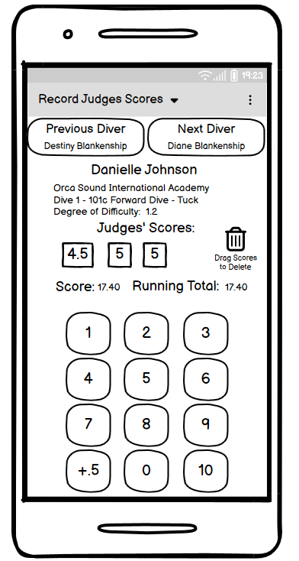
Record Judges Scores - Score Added
New score added to the score list
Dive score is automatically calculated from entered scores
Running total is automatically updated by adding in this dive score
New for Prototype 3
Same modification of Score and Running Total
User selects “+.5”

Slide 27
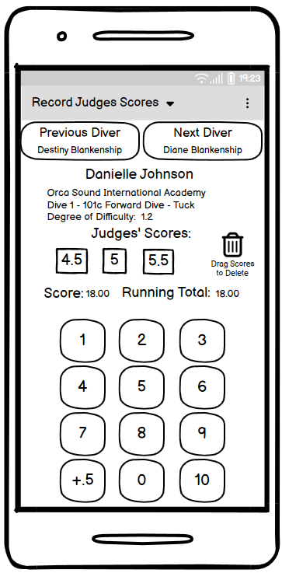
Record Judges Scores - Score modified by half point
The last score entered, the 5, is modified to add a half point
The last score is displayed as 5.5
Running total is automatically updated by recalculating the dive score with the 5.5 instead of 5
New for Prototype 3
Same modification of Score and Running Total
User selects “Next”

Slide 28
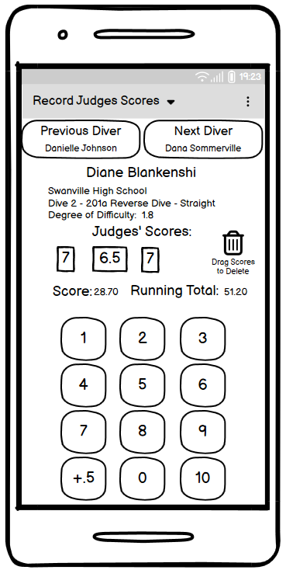
Record Judges Scores - Next Diver
Scores are added using the same process
Diver information and recorded scores for that diver are shown
A mistake on the judges scores for the last dive was verbally indicated by an official.
The scorekeeper chooses Previous Diver to correct that score.
New for Prototype 3
Same modification of Score and Running Total
User selects “Previous Diver”

Slide 29
Record Judges Scores- Correct Scores
The current scores are dragged to the trash can and disappear.
New for Prototype 3
Same modification of Score and Running Total
User drags scores to the trash can

Slide 30
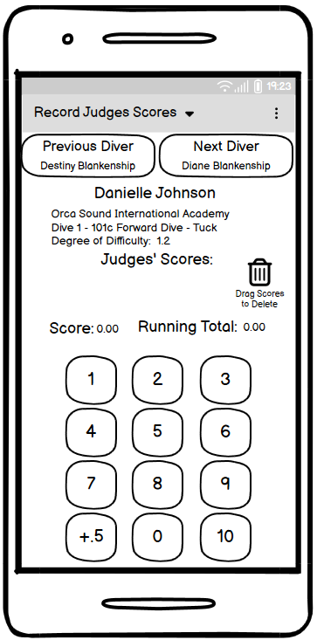
Record Judges Scores - Delete Scores
Scores that were dragged to the trash are deleted
Dive score and running total are updated accordingly
The newly entered scores that the judges flashed on scorecards as a correction are added to replace the deleted scores
Dive score and running total are updated accordingly
New for Prototype 3
Same modification of Score and Running Total
User taps in the corrected scores

Slide 31
Record Judges Scores - No Scores
If the diver has withdrawn, then no scores are entered.
The Scorekeeper taps Next Diver.
A message will popup to remind the scorekeeper that the dive has not been scored and ask if the diver has been withdrawn.
If the scorekeeper selects withdrawn, the diver will not appear again in the diving rotation.
New for Prototype 3
Same modification of Score and Running Total
User selects the drop down to go to
“Dive Event Progress”

Slide 32
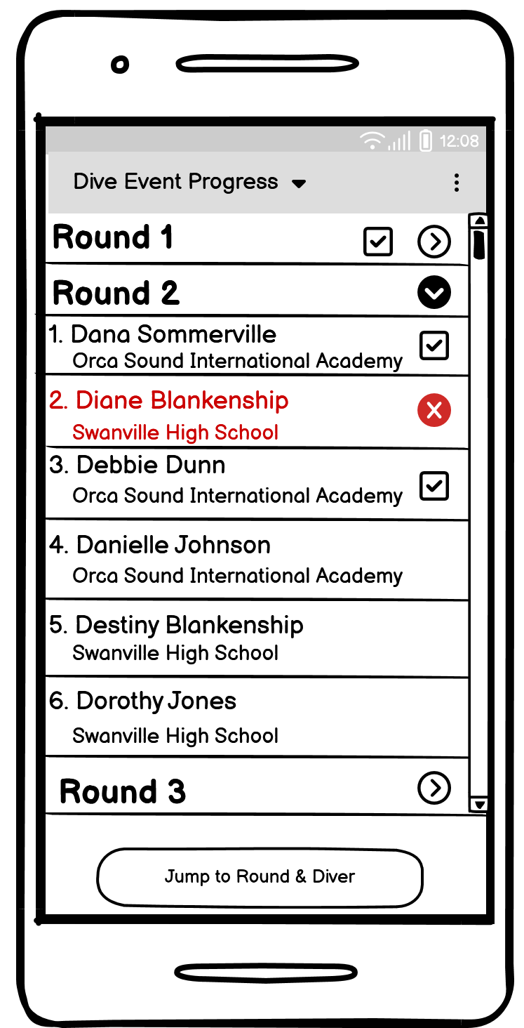
Dive Event Progress
[No changes from Prototype 2]
[No changes from Prototype 2]
The Scorekeeper can use this screen to review the divers and jump to the correct Round and Diver if the user loses their place in announcing.
The checkmarks in the square boxes show the dives that have been scored.
The red x shows the withdrawn divers. The user can tap the x to undo a withdrawal made in error.
One round can be expanded which will contract the previously expanded round.
User taps Diver name for correct Round & selects “Jump to Round & Diver”

Slide 33

Record Judges Scores - All Scores Entered
When the last diver appears to Record Judges Scores, the Next Diver button changes to Finish Event.
New for Prototype 3
Same modification of Score and Running Total
User selects “Finish Event”

Slide 34
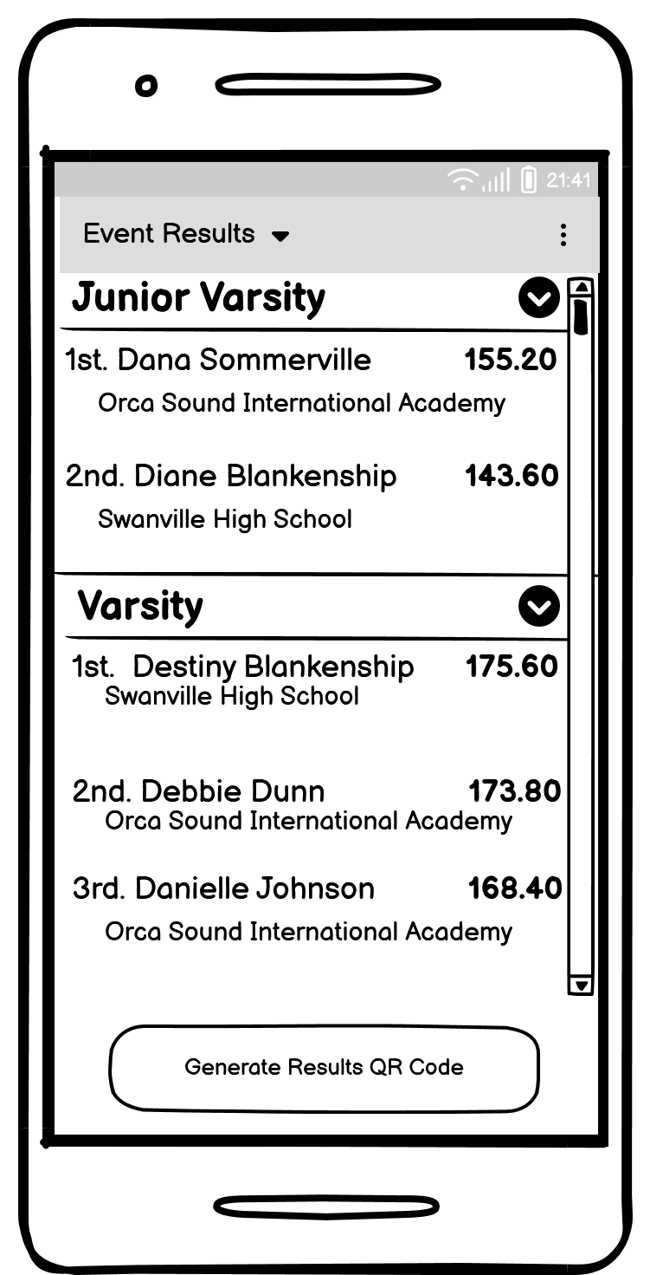
Results - List Results
[No changes from Prototype 2]
Accordion control allows for viewing the results of the different diver levels of competition within the event
Divers from the expanded level are displayed along with their placing and total score
The Scorekeeper hands the results to the Announcer for announcement
User selects “Generate Results QR Code”

Slide 35
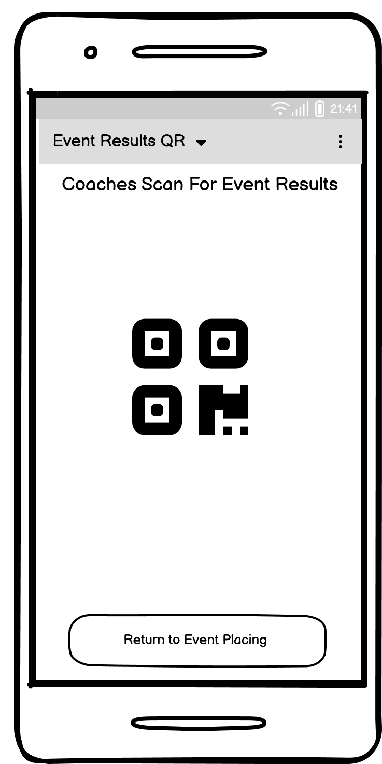
Results - QR Code
[No changes from Prototype 2]
QR code contains scores for all divers for the event.
The coaches can scan the code to get those results
Return to Event Placing button will take the user back to the results screen that displays the diver scores and placings

Slide 36
Drop down bar
[No changes from Prototype 2]
The drop down can be used to jump between functionality.
Only Event Selection is enabled until an event is selected.
The options include:
Event Selection
Event Setup
Add Divers
Record Judges Scores
Dive Event Progress
Event Results
Event Results QR

Slide 37
Minor Task 1: Announce Event
Android Mobile

Slide 38
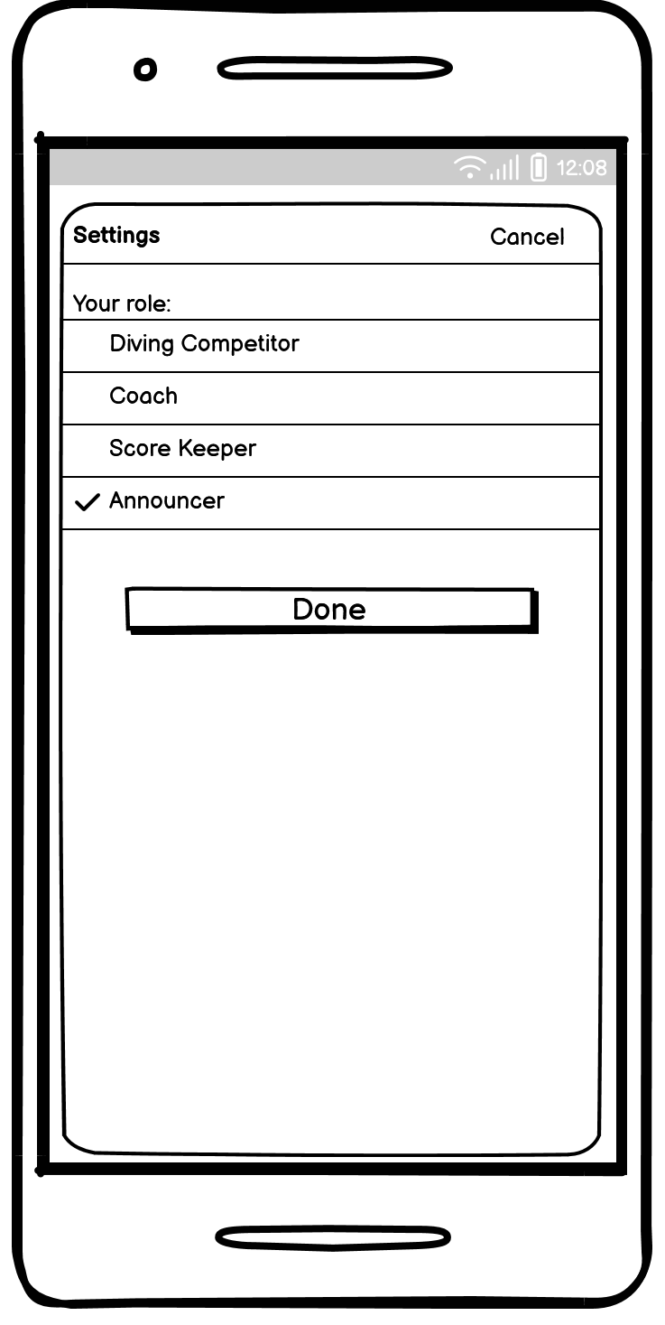
Setup
[No changes from Prototype 2]
Announcer is a transient role
No settings are collected
Only one event can be on the announcer’s app at any one time.
User selects “Done”

Slide 39
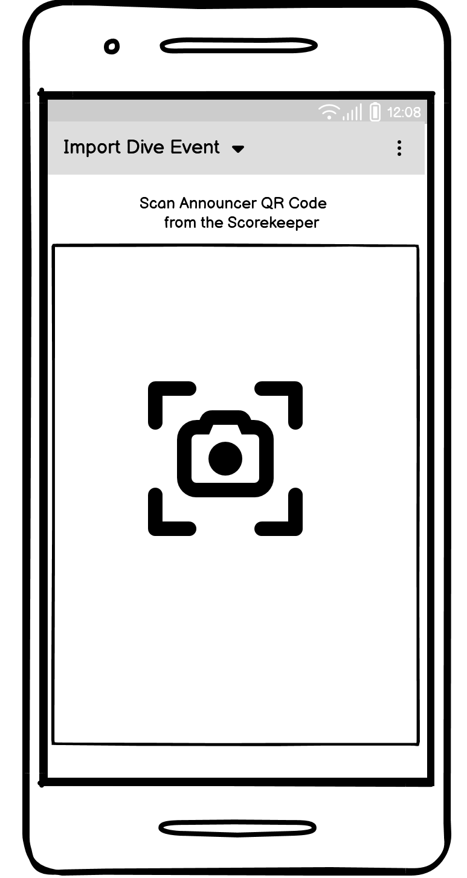
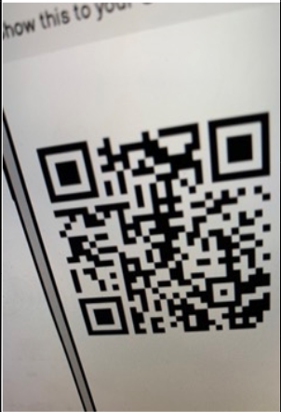
Import Dive Event
The drop down menu has the following choices:
Import Dive Event
Announce Dive Event
Dive Event Lineup
Dive Event Progress
Only Import Dive Event is enabled until a Dive Event has been imported.
The Announce can switch to any menu item while using the app
When opening the app, if settings are complete, this will be the first page
New for Prototype 3:
Added “Live Camera View” picture
Why? User did not realize similar slide was a live camera during user testing.
User scans the QR code from the Scorekeeper

Slide 40
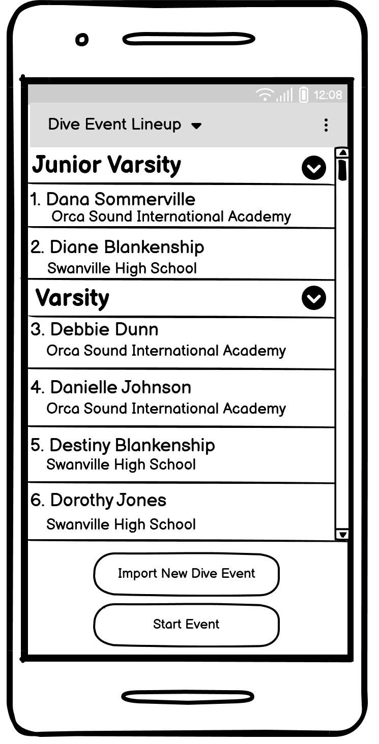
Dive Event Lineup
[No changes from Prototype 2]
After scanning an event, the app will transition to the Dive Event Lineup
The Announcer can use the quick button to import a new lineup if they see it is not the correct lineup
When the Announcer is ready to start announcing, user selects Start Event
User selects “Start Event”

Slide 41
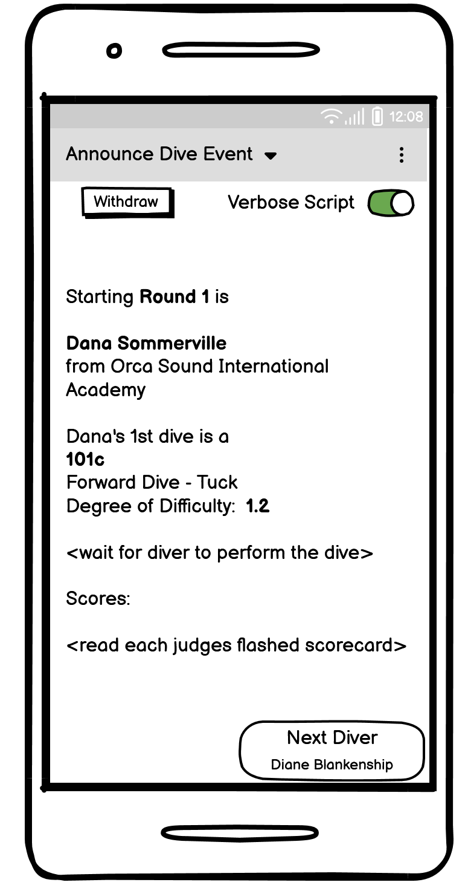
Announce Dive Event
[No changes from Prototype 2]
The app defaults to Verbose Script
The reads exactly what is shown on the screen except for the instructions in <>
After reading the scores, then Announcer can proceed to the next diver.
User selects “Next Diver”

Slide 42
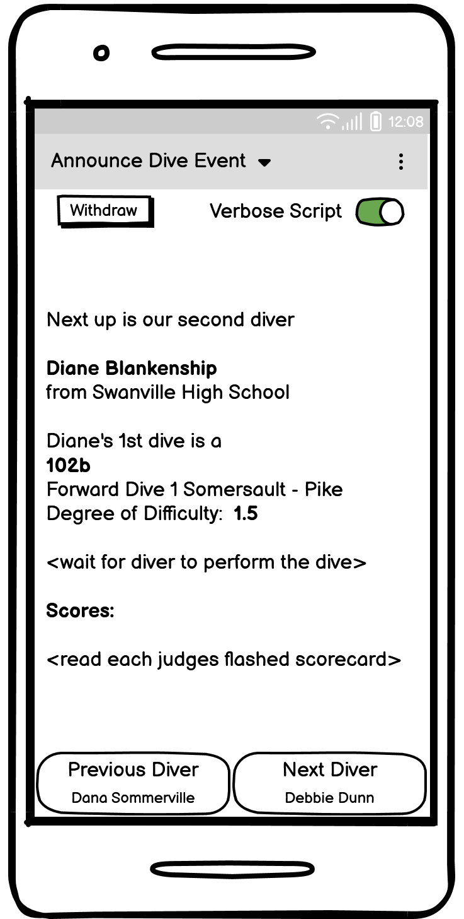
Announce Dive Event
[No changes from Prototype 2]
The script continues for the next diver making all necessary adjustments to the wording
Announcer has quick access to previous diver if advanced before ready
User selects “Next Diver”

Slide 43
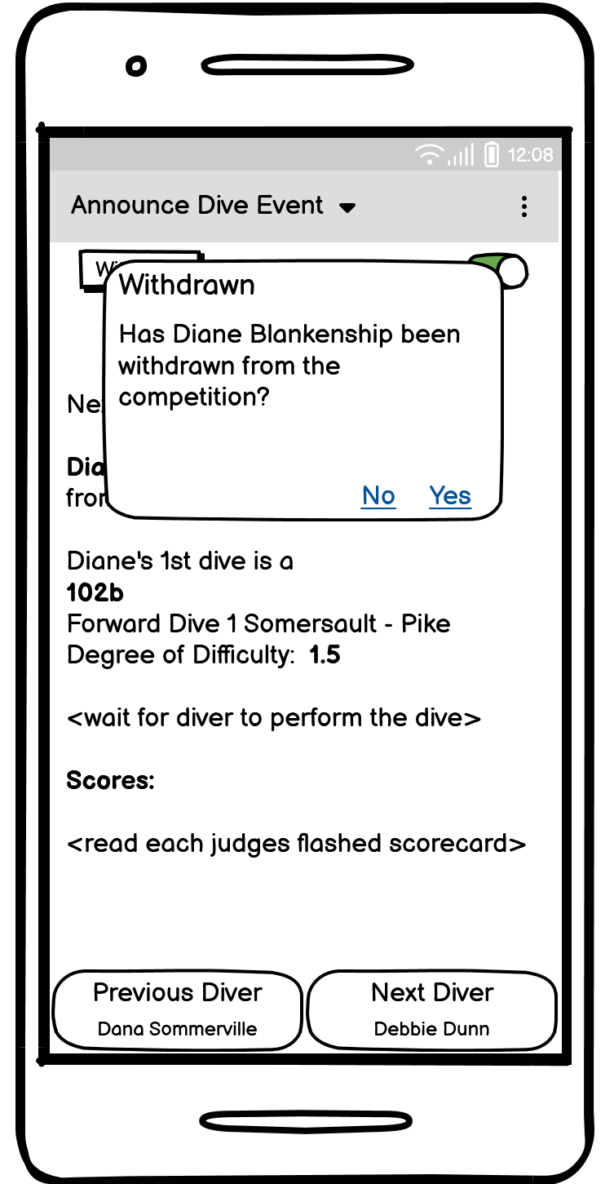
Announce Dive Event
[No changes from Prototype 2]
If a diver needs to Withdraw from the event possible due to injury, the announcer needs to remove the diver from the script.
The announcer can choose No if Withdraw was accidently selected.
The diver is removed from all further rounds of the script.
User selects “Withdraw & yes”

Slide 44
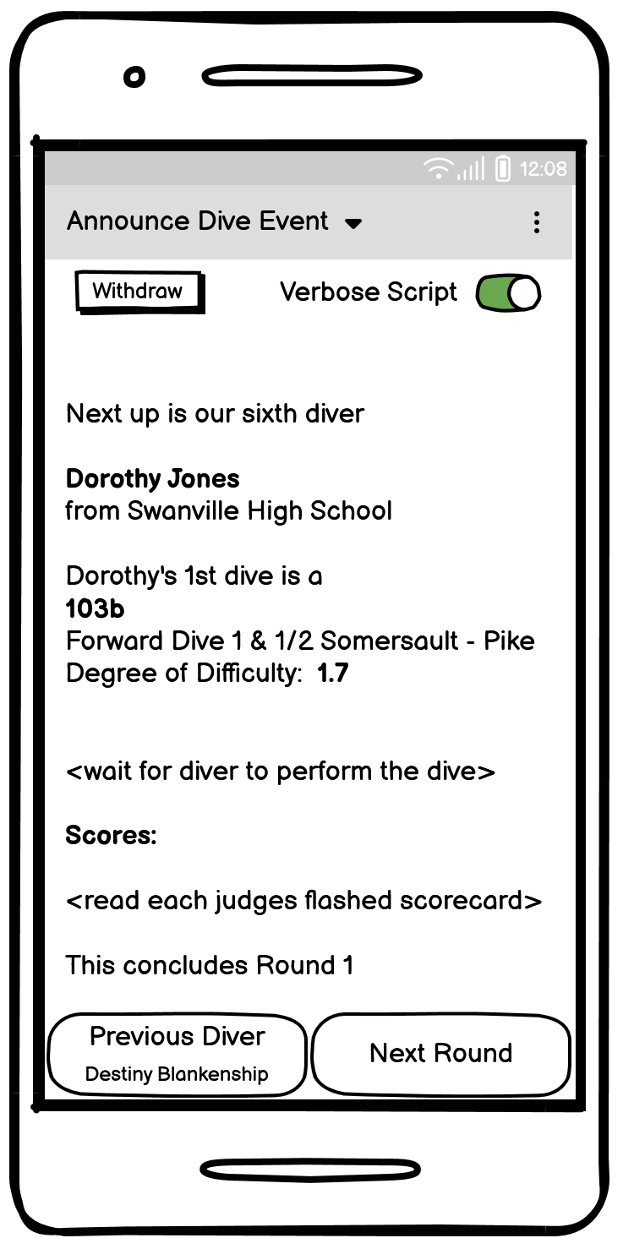
Announce Dive Event
[No changes from Prototype 2]
The script adjusts for the last diver of the Round in order for the announcer to identify the change in Rounds.
User selects “Next Round”

Slide 45
Dive Event Progress
[No changes from Prototype 2]
The Announcer selected the drop down menu item of Dive Event progress.
The Announcer can use this screen to sync up with the scorekeeper if the user loses their place in announcing.
The checkmarks in the square boxes show the progress made in the announcers script.
The red x shows the withdrawn divers. The user can tap the x to undo a withdrawal made in error.
One round can be expanded which will contract the previously expanded round.
User taps Diver name for correct Round & selects “Jump to Round & Diver”

Slide 46
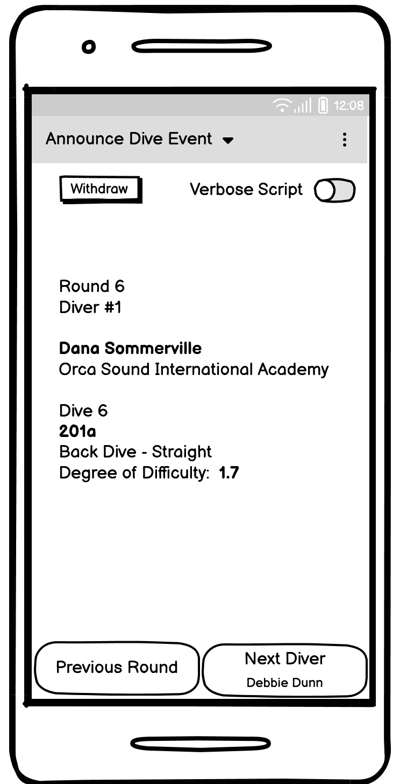
Announce Dive Event
[No changes from Prototype 2]
The Announcer selected to turn off the verbose script
When an announcer is experienced, the user can turn off the verbose script an fill the announcing commentary without the script.
User selects “Next Diver”

Slide 47
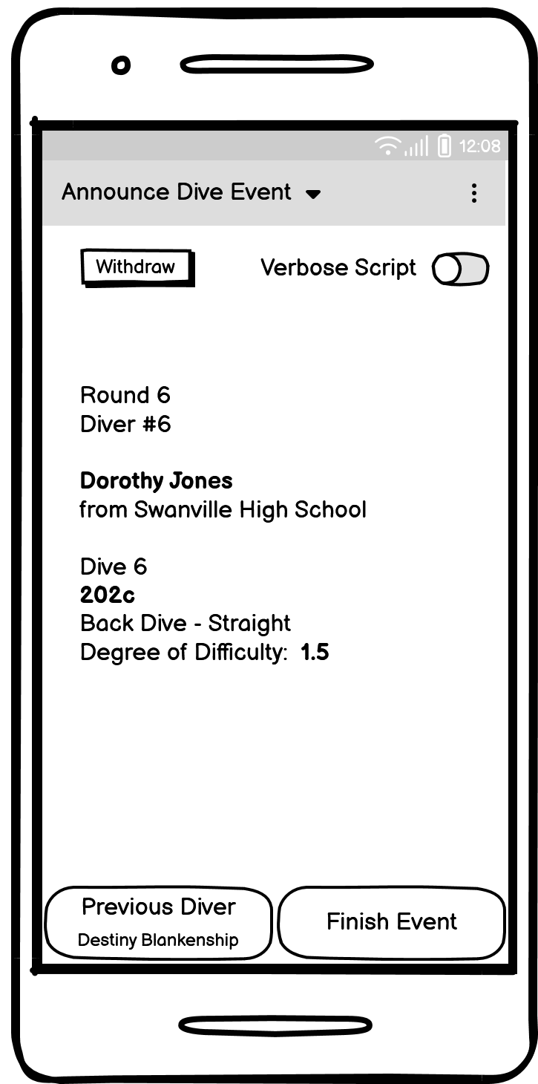
Announce Dive Event
[No changes from Prototype 2]
When the app reaches the last diver, the button changes from Next Diver to Finish Event.
Announcer can still go back to Dive Event Progress to jump to any Diver and Round
This event remain on the phone of the announcer unless it is replaced by scanning a new event or the announcer removes the app.
User selects “Finish Event”

Slide 48
Announce Results
The announcer needs a separate app from the Scorekeeper during the event to work together closely.
After the event concludes, the announcer will read the results from the Scorekeepers app.
See Scorekeeper app for details.

Slide 49
Minor Task 2: Coach Collects Dive Entries
iOS Mobile

Slide 50
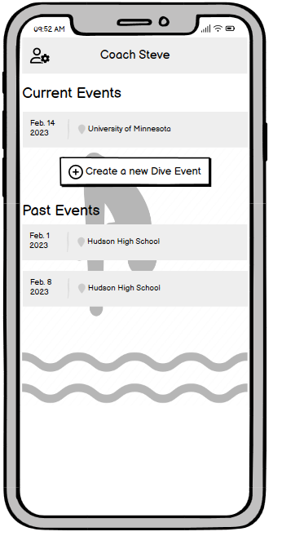
Coach Home Page
[No changes from Prototype 2]
Coach's home screen with list of past and current events
Settings available in the top left
Clicking on Current Event will bring you to Dive Event sheet for Current Dive Event
Clicking on Past Event will show results of Past Event
“Create a new Dive Event” will create an empty Dive Event
User selects “Create a new Dive Event”

Slide 51
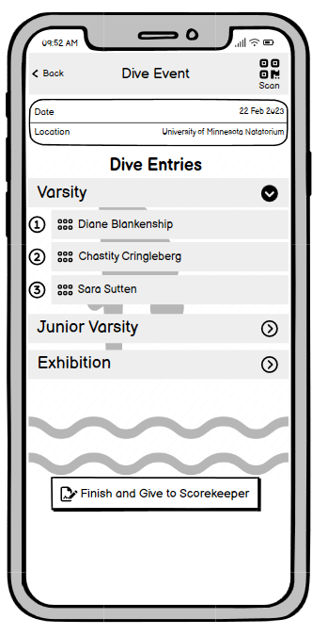
Dive Event
[No changes from Prototype 2]
Dive Event screen for Coach
Dive Event date and location visible at the top
Varsity, JV, and Exhibition competition level accordion menu options, expand when clicked, multiple sections can be expanded at once
By tapping on the Dive Entry, the entry can be edited, re-scanned (from edit sheet), reordered (via grippers), or deleted (via swipe left). A coach can reorder between level (e.g. move a varsity dive entry to jv)
Scan button (top right) used to scan Dive Sheet QRs (similar to Scan Event Results screen) and populate the Dive Entries list
User selects “Finish and Give to Scorekeeper”

Slide 52
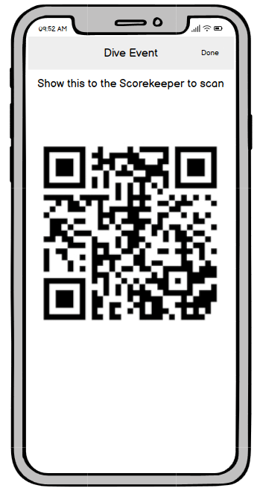
Dive Event QR
[No changes from Prototype 2]
All extra borders and chrome are hidden to help make scanning easier. The top title and instruction fades out after a few seconds to facilitate this
A tap anywhere re-reveals the top bar/done button. "Done" returns to the Dive Event screen.
A *swipe* anywhere dismisses this screen and returns to the Dive Event screen. (Swipe is the platform convention for dismissing full-screen photos)
User selects “Done”

Slide 53
Minor Task 3: Official Reviews Dive Entries
Android Mobile

Slide 54
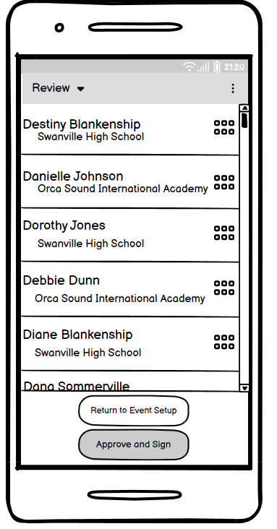
Event Review (Scorekeeper App)
Note: The official only has one task that utilises our application, therefore we made the decision that this task will take place on the Scorekeeper’s device. This task starts from the “Event Setup” screen on the Scorekeepers App
Scorekeeper will hand the device to the official
Clicking on a Dive Entry will bring up a Dive Entry Review screen
Official may reorder the divers within the levels to ensure fairness
Approve and Sign is not enabled until all Dive Entries have been approved
Return to Dive Setup returns the user to the Scorekeeper Dive
New for Prototype 3:
“Return to Event Setup” button
Improved workflow of official review
Why? We did not test on this task during user testing. However, there was some confusion when we asked the user to initiate the official review. We made changes to the scorekeeper task accordingly, and thought it made sense to flesh out this minor task to ensure a smooth and intuitive user experience.
User (official) selects Destiny Blankenship’s Dive Entry

Slide 55
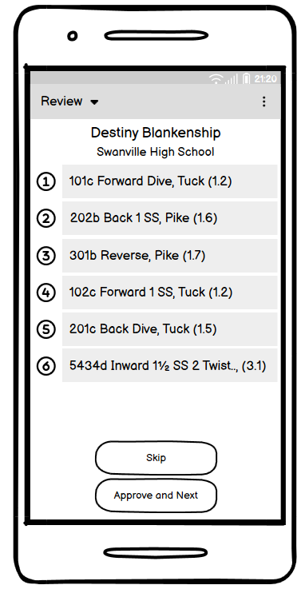
Dive Entry Review
Clicking "Approve and Next" brings up the next Dive Entry for review. On last entry, button reads "Approve and Done"
If the official does not approve of the dive entry, they can click skip to move on to the next dive entry
Once done, the official hands the device back to the Scorekeeper
New for Prototype 3:
Removed signing individual dive entries
Added option to skip approving current dive entry
Why? We did a mini cognitive walkthrough on this minor task and noticed a distinct lack of “escape” functionality. The skip button is an attempt to provide that to the user.
User (official) selects “Approve and Next”

Slide 56
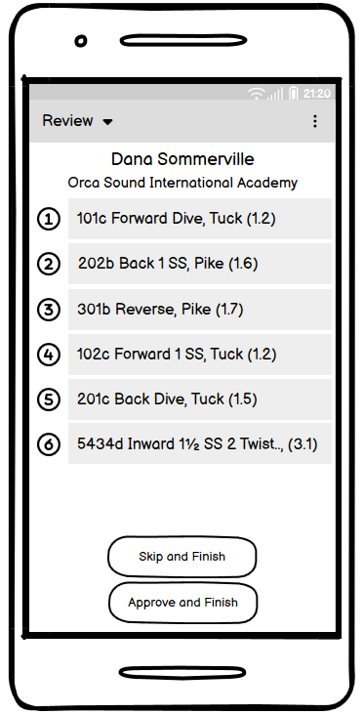
Dive Entry Review - Last
On the last dive entry of an event, the buttons change to “Skip and Finish” and “Approve and Finish”
Clicking either brings user to main dive entry review page
New for Prototype 3:
Same modification of Skip and removing the signing
User (official) selects “Approve and Finish”

Slide 57
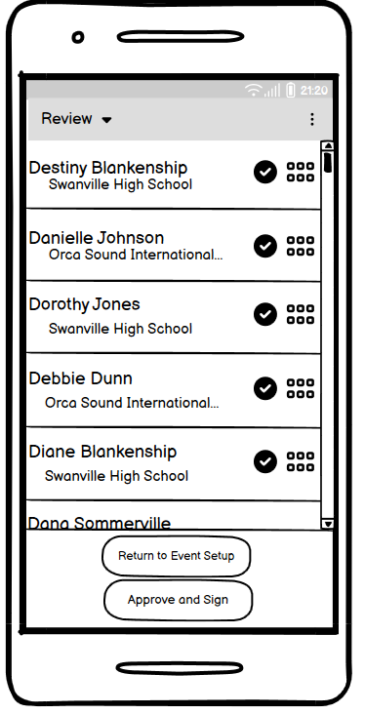
Dive Event Review - Ready to Sign
All dive entries that have been approved now have a check mark.
User can find and click on any dive entries that do not have check mark to approve
All entries must be approved for “Approve and Sign” to be enabled
New for Prototype 3
Check marks next to approved dives
Signing entire dive event
Why? During our walkthrough we noticed it was not clear to the user the progress they were making towards their goal of approving a dive event. We added check marks to show this progress.
User (official) selects “Approve and Sign”

Slide 58
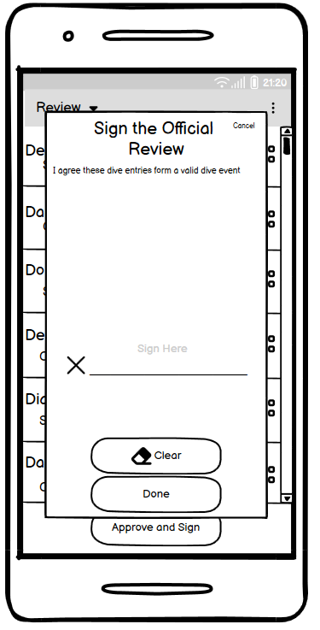
Signing Official Review
New for Prototype 3:
New signing screen for official
Cancel brings user back to main review screen
Done is not enabled until something has been entered on signature line
Clear erases anything in signature line and re-disables Done
Clicking done brings user to Dive Event Setup with modified button options
Why? We thought it was overkill for the official to sign each dive entry. Therefore we made the change so they only have to sign once. Followed style guidelines to match this window to other instances of user signing.
User (official) signs and clicks “Done”

Slide 59

Approved Event Setup
New for Prototype 3:
New, unmodifiable event setup screen
After an Official has reviewed, approved, and handed the device back to the scorekeeper
User can start event
User can modify divers, which bring them back to the modifiable event setup screen. Official review must happen again if event is modified.
Why? We want the scorekeeper to be the user to start the diving event and give them an opportunity to make last minute changes before the event.

